Slide 1

RUNGTA COLLEGE OF DENTAL SCIENCES AND RESEARCH
CASTING PROCEDURES DEFECTS AND METHODS OF COMPENSATION
DEPARTMENT OF CONSERVATIVE DENTISTRY AND ENDODONTICS

Slide 2
Specific learning Objectives
At the end of this presentation the learner is expected to know ;
Core areas* | Domain ** | Category #
Introduction, steps in casting, casting defects | Cognitive | Must know
Definitions, porosity | Psychomotor | Nice to know
Die materials, recent advances in casting | Affective | Desire to know

Slide 3
Contents.....
Introduction
History
Glossary of Prosthodontic terms
Basic cavity designs
Die Materials
Wax Pattern
Sprue Design
Casting Ring/ liners
Investments and procedures
Burn Out procedure
Casting Machine and Crucible
Ringless casting system
Casting Defects
Methods of Compensation
Recent Advances
Conclusion

Slide 4
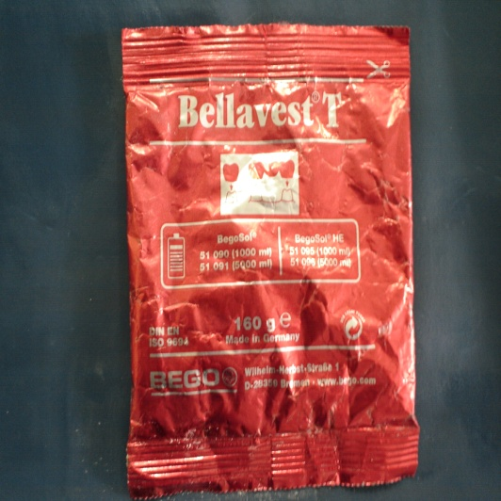
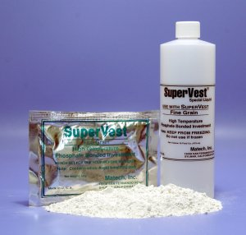
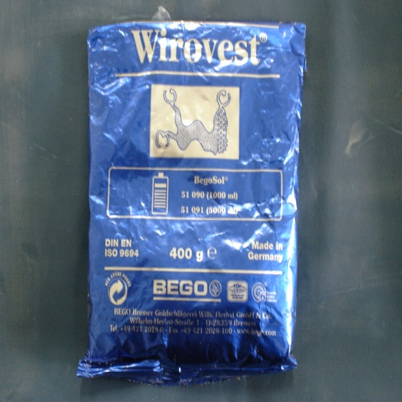
Investment Material
GPT - A material consisting principally of an allotrope of silica
and a bonding agent. The bonding substance may be gypsum
(for use in lower casting temperatures) and phosphates and silica
(for use in higher casting temperatures).
Gypsum bonded investment – conventional gold alloys
Phosphate bonded investment – metal ceramic & some base metal alloys
Ethyl silicate bonded investment – base metal alloys

Slide 5
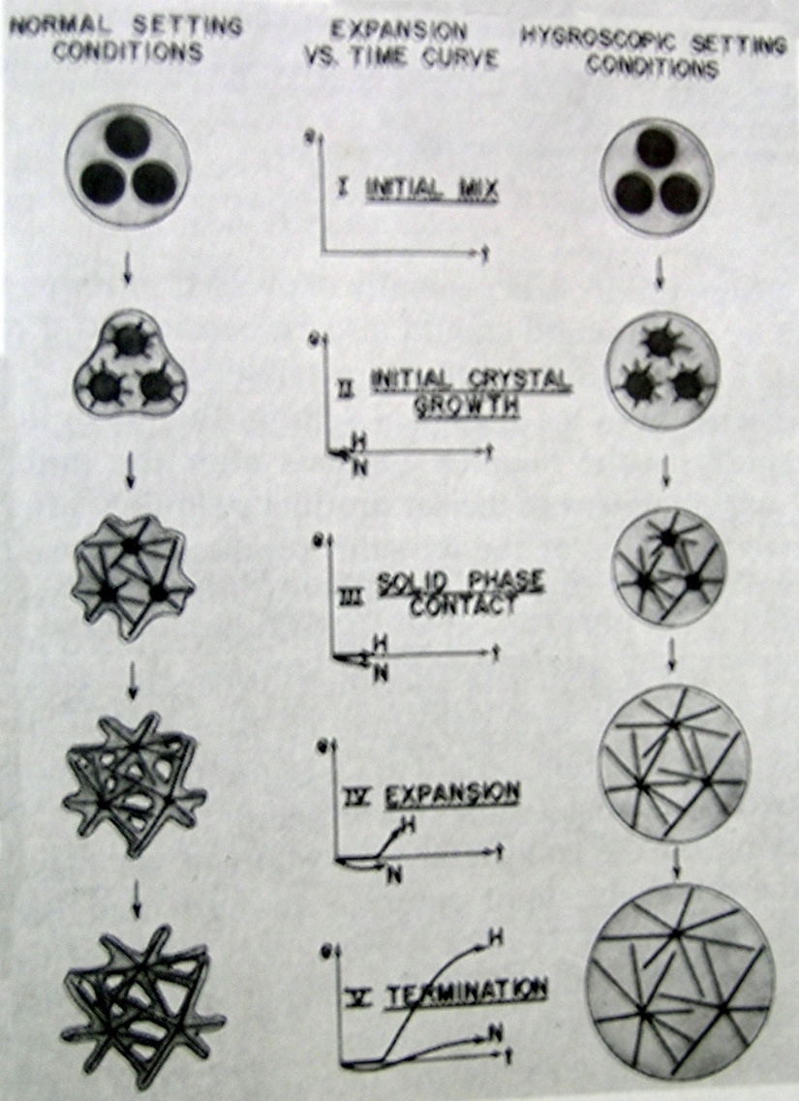
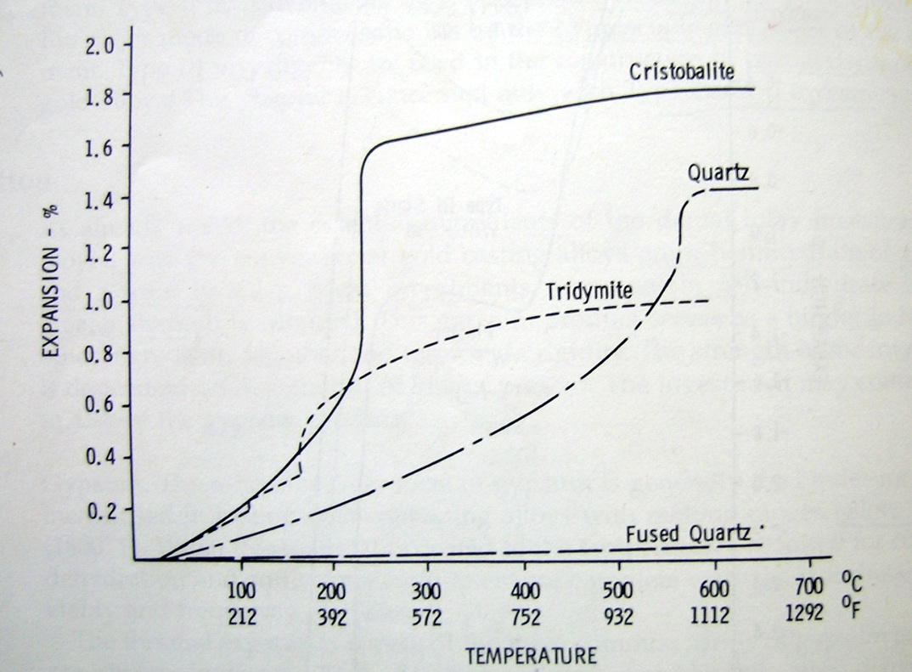
Gypsum bonded investments

Slide 6
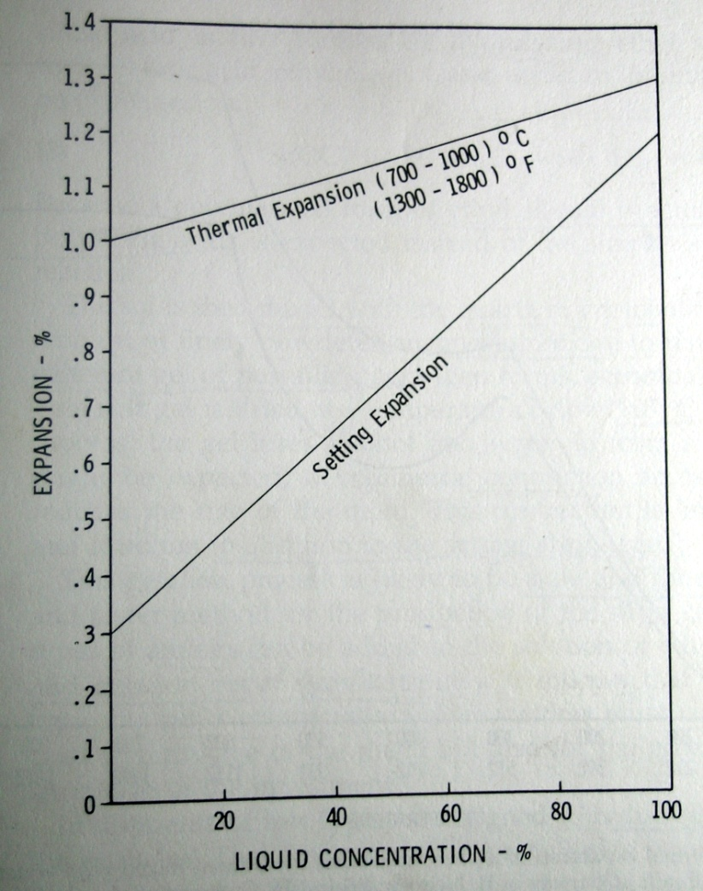
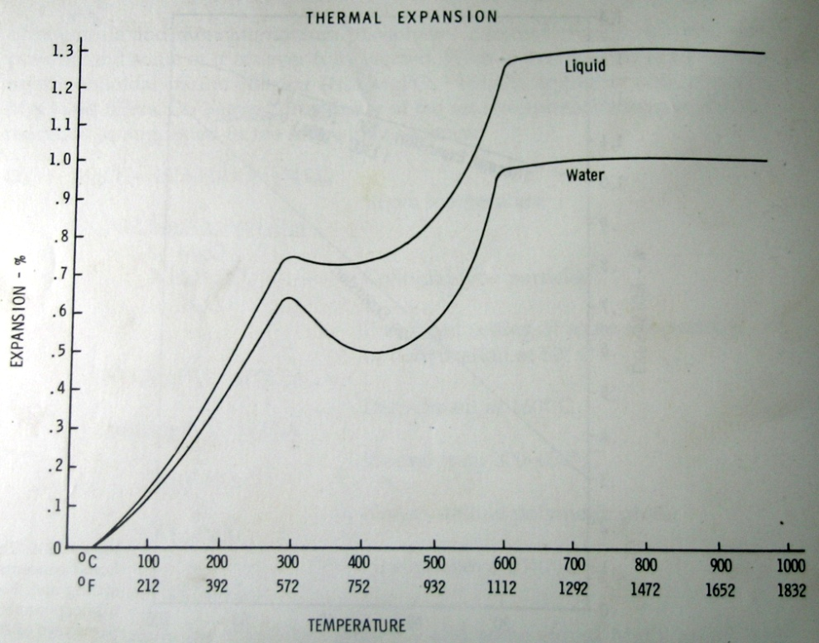
Phosphate bonded investments

Slide 7
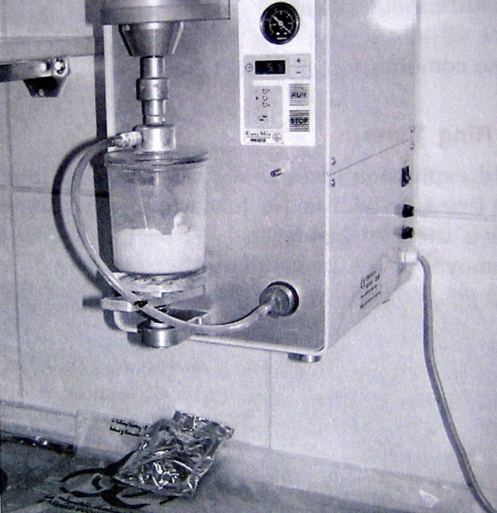
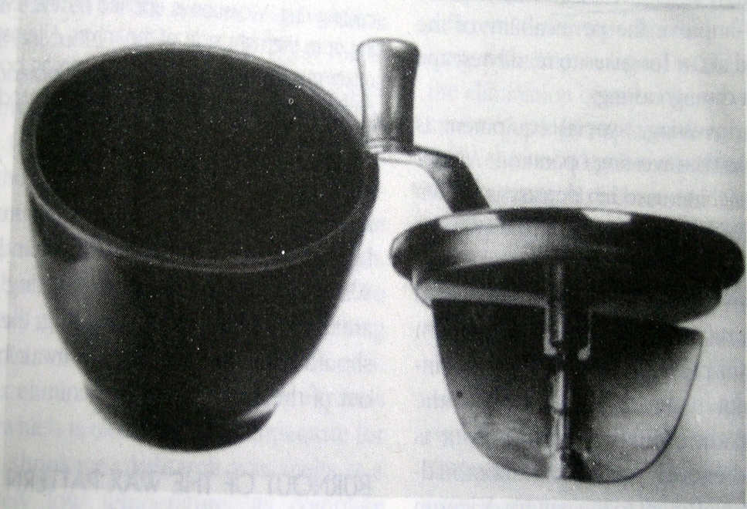
Investing Procedure
IMPORTANT TIPS
  1. Investment should always be added to the water.
  2. Equipment must be kept clean and free of set investment.
  3. Close the container when not in use.
  4. Always store the investment in a dry area.
Vacuum mixer Mixing bowl

Slide 8
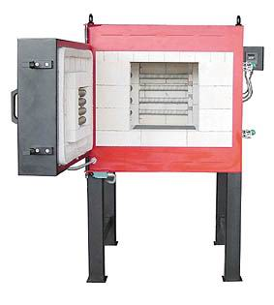
Burn out procedure
Heating the investment in a thermostatically controlled furnace until the wax is burned out
Creates a mold space
Provides thermal expansion of
  investment

Slide 10
Techniques
Hygroscopic low heat tech – 500° C for 60 min to 5 hours
  37° C water bath
  Warm water from top
  Thermal expansion
High heat thermal expansion tech
  Gypsum bonded - 650 – 700 ° C in 60 min & held for 15 – 30 min
  Phosphate bonded – 750 to 900 ° C , slow to 315 ° C and rapid to upper temp & held for 30 min
  Thermal expansion
  Heat of reaction expanding the wax pattern
  Setting expansion

Slide 11
Time allowable for casting
The time lapse between burn out and casting – critical
  for high heat technique
One minute can pass without a noticeable loss in dimension
Applicable for low heat technique also

Slide 12
Burn out procedure
Heating the investment in a thermostatically controlled furnace until the wax is burned out
Creates a mold space
Provides thermal expansion of
  investment

Slide 14
Time allowable for casting
The time lapse between burn out and casting – critical
  for high heat technique
One minute can pass without a noticeable loss in dimension
Applicable for low heat technique also

Slide 15
Water films
Appear as MINUTE RIDGES OR VEINS on the surface
If pattern is moved during investing
Lack of intimate contact of investment with wax pattern
Remedy – Surfactant
Increased W:P ratio

Slide 16
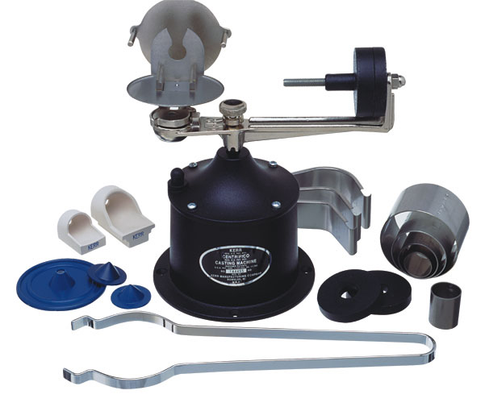
Casting
GPT - n → something that has been cast in a mold ; an object formed by the solidification of a fluid that has been poured (or) injected into a mold
verb → The act of forming an object in a mold.
Heat source – melts the alloy
Casting force – forces molten alloy into mold
Casting force > surface tension of alloy + resistance offered by gas in the mold.

Slide 17
Heat Source
Torch melting
→ Gas air
→ Gas oxygen
→ Air acetylene
→ Oxygen acetylene
→ Hydrogen oxygen generator
Electrical melting
→ Electrical resistance melting
→ Direct current arc melting
→ Induction melting
Excess heat changes composition of alloy
Base metal alloys are made brittle

Slide 18
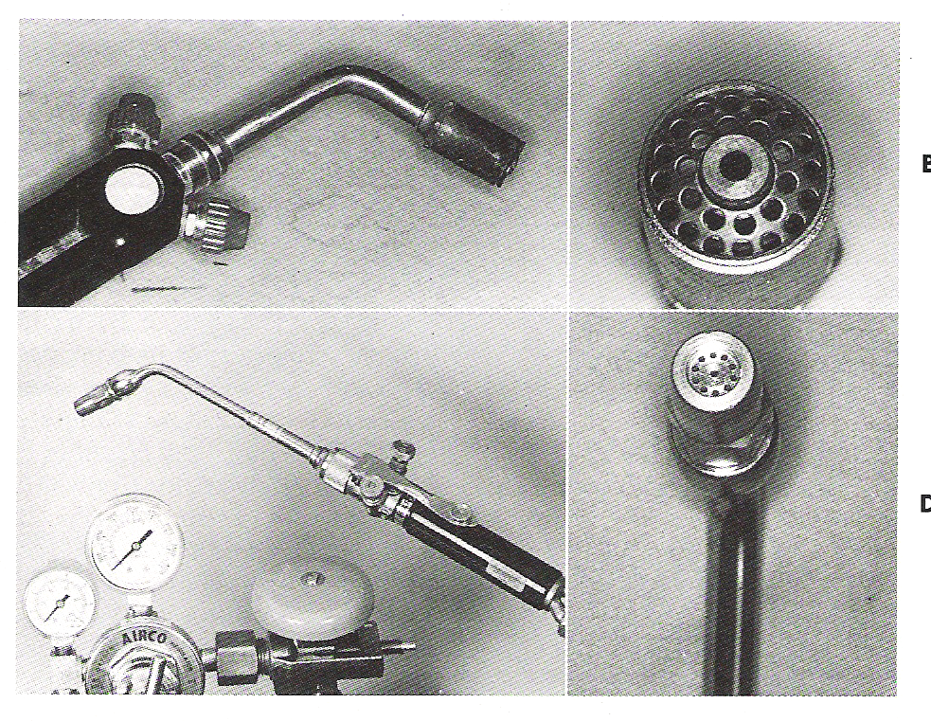
Torch melting
Gas-air torch
Melts conventional noble metal alloys (melting temp <1000°C).
2 separate tubes connected to a single jet nozzle

Slide 19
Gas oxygen torch
Melts metal ceramic alloys of temp.1200°C. and base metal alloys
Nozzle may have single orifice/multiorifice.

Slide 20
Hydrogen - oxygen Generator
Electrolytic cell- to produce hydrogen and oxygen by electrolyses of water
Temperature of flame altered and adjusted by passing H2 & O2 through a liquid called a gas atomizer.

Slide 21

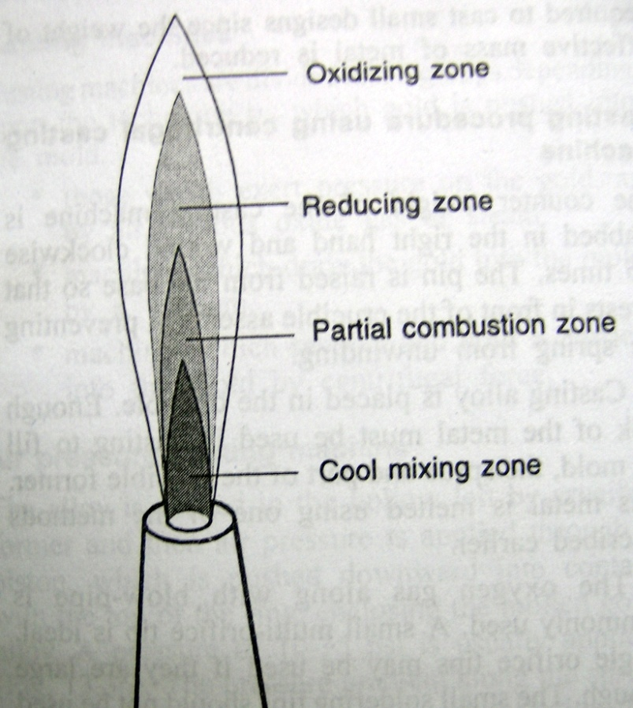
Zones
Zone 1 - Colorless cone
-mixture of gas and air. No heat is present
Zone 2 - Combustion zone – green
- partially burnt.should be kept away from metal during fusing.
Zone 3 - Reducing zone – dimly blue.
- hottest part of flame. should be in contact with metal.
Zone 4 - oxidizing zone – the combustion occurs with oxygen in air.

Slide 22
Molten alloy
Low fusing gold alloy
Reducing flame –casting appears shiny and mirror like
Oxidising flame-Cloudy and dull film
At proper temp. – light orange, tends to spin and follow the flame(38-66°C above liquidus temp)
High fusing gold alloy
-appear white hot, almost vaporous state
Nickel chromium alloy
-corner rounded over , not allowed to pool (overheating)

Slide 23
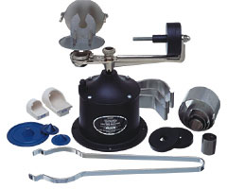
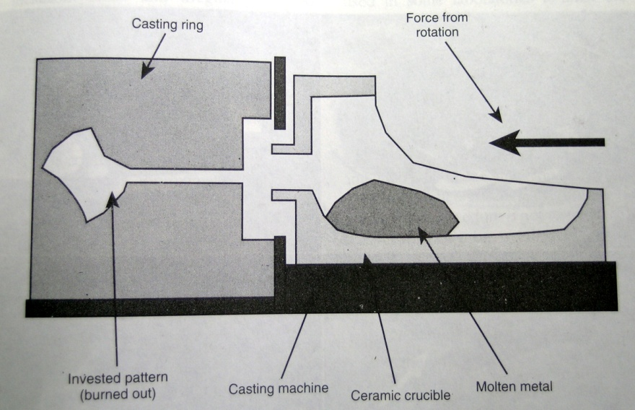
Torch melted spring wound Centrifugal casting machine
Spring wound – 2-5 turns
Glazed ceramic crucible
Broken arm - rotational speed
Hydrostatic pressure gradient - 30 – 40 psi (0.21 to 0.28 Mpa) at the tip of the casting – Temp gradient.

Slide 24
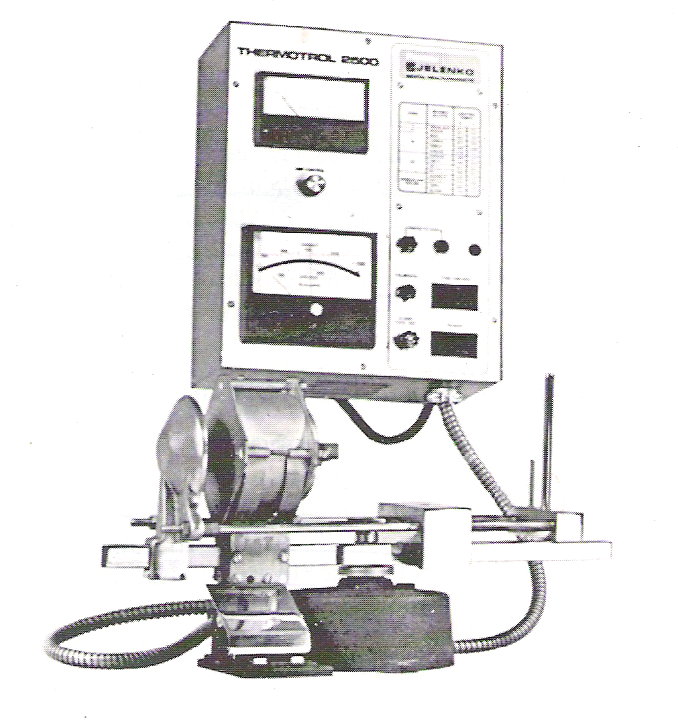
Spring wound Electric resistance heated casting machine
Electrical current is passed through a resistance heating element which causes melting of the alloy in the crucible.
Melts ceramic alloys in graphite crucible
Better temperature control & convenient
Prevents over heating
Oxidises the metal ceramic alloys on overheating
Crucible is against the casting ring - metal button remain molten slightly longer- complete solidification.
Carbon crucible not used with palladium alloys (melting temperature > 1504°C )

Slide 25
Direct current arc melting machine
An Electrical arc is created at the end of two electrodes – alloy and cooled tungsten electrode
Melts higher fusing alloys – temp within the arc exceeds 4000°C
Current is selected according to which alloy is being melted
Electrodes - attached both to negative &positive terminal.( placed about 5cm apart.)
High risk of over heating of alloy

Slide 26
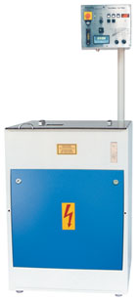
Induction casting
Melts base metal alloys of high melting temp.
The alloy is melted by an induction field that develops within a crucible surrounded by water cooled metal tubing.
The furnace consists of a transformer in which alternating current flows through the primary winding coil – variable magnetic field
Consists of crucible with copper coil wound circularly.

Slide 27
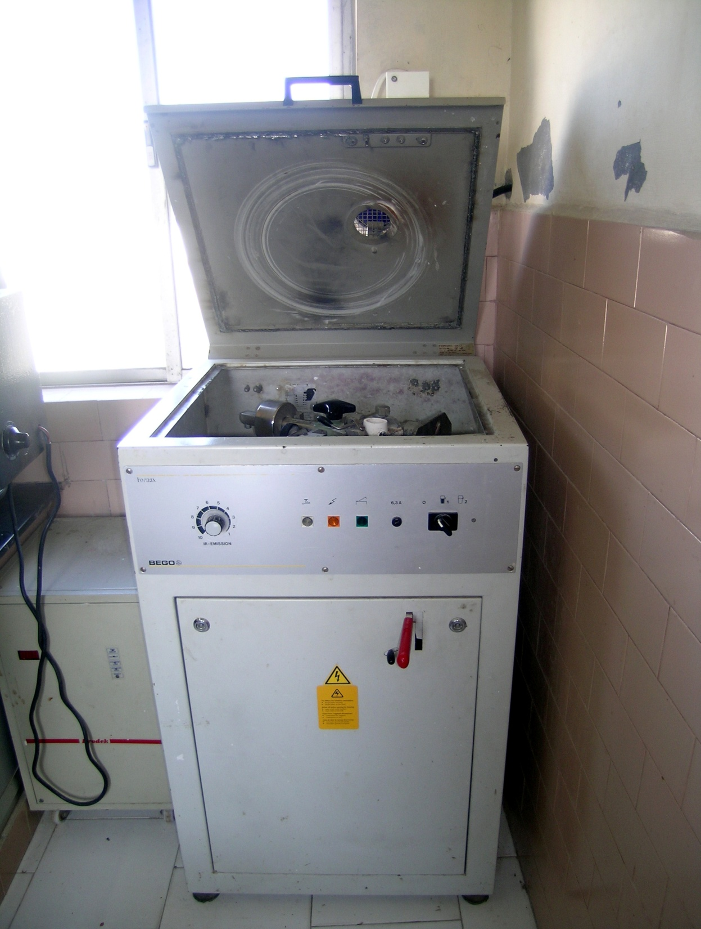
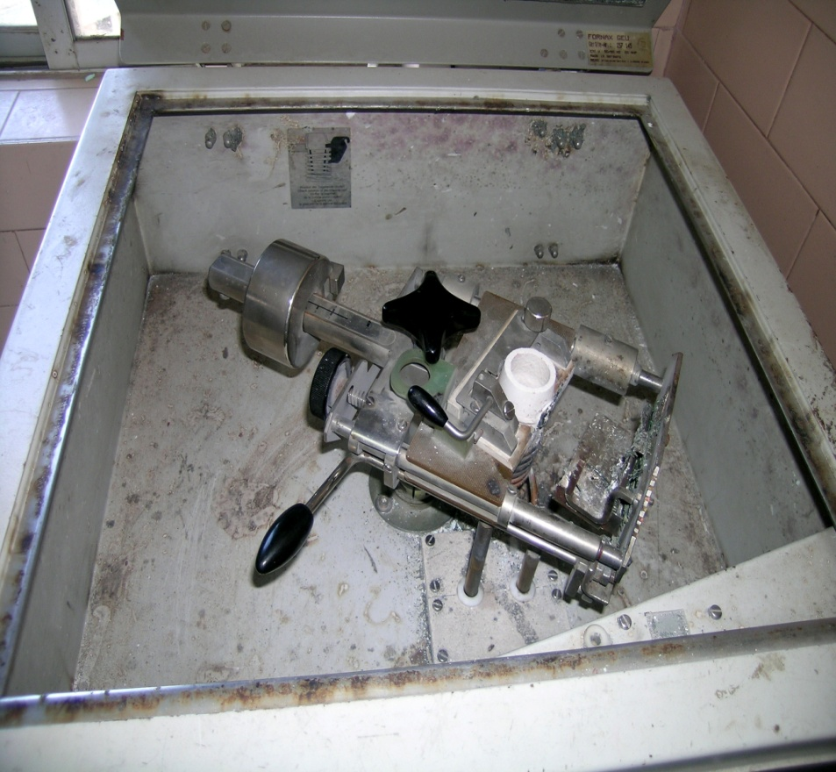
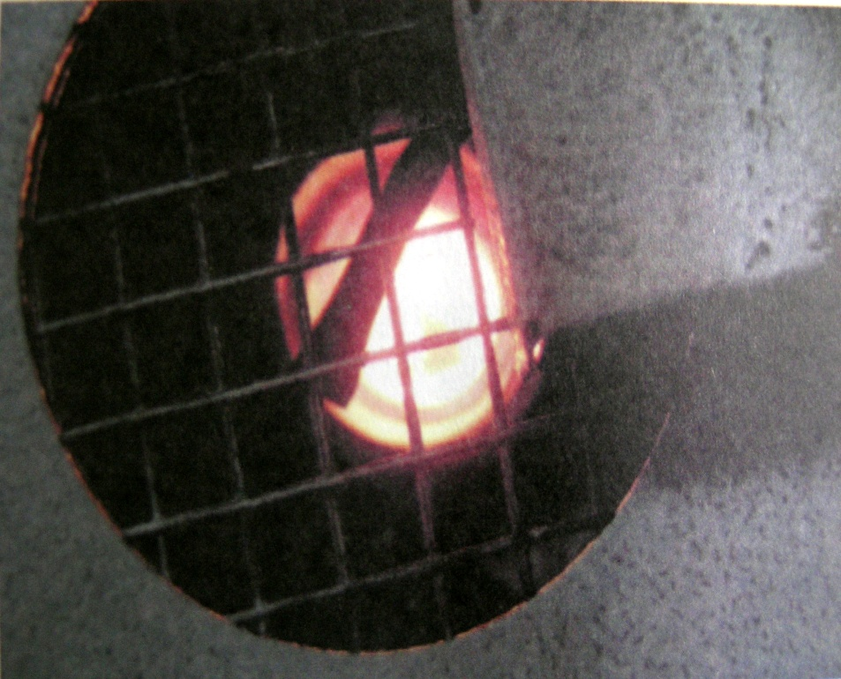

Slide 28
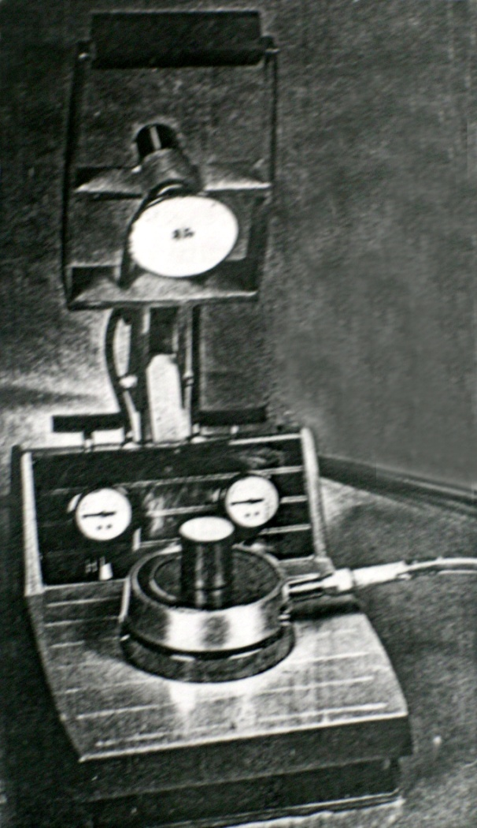
Vacuum or Air Pressure assisted casting machine
Alloy melted in the crucible hollow of the ring
Vacuum is applied at the base of the mold so that the flow of the molten alloys is helped by a suction from the base
Air tight piston – 10 – 15 psi (0.1 to 0.14 Mpa)
No pressure gradient
Heat transfer based on the thickness of the casting

Slide 29
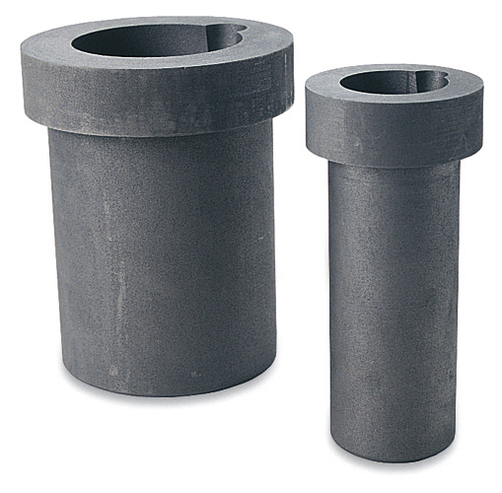
Crucibles
GPT - A vessel / container made of any refractory material (as porcelain) used
for melting / calcining any substance that requires a high degree of heat.
Carbon crucibles – for high noble crown and bridge & higher fusing gold-based metal ceramic alloys.
Not used with high pd /pd-Ag alloys and with Ni-Cr/Co-Cr base metal alloys.

Slide 30
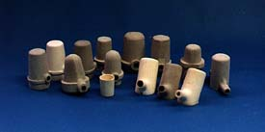
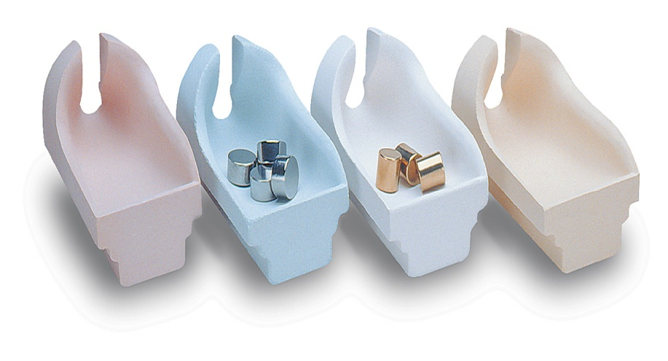
Clay crucibles - high noble and noble metal alloys
Quartz /zirconia - alumina crucibles - high-fusing alloys of any type ,base metal , palladium alloys

Slide 31
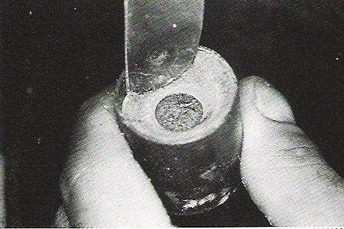
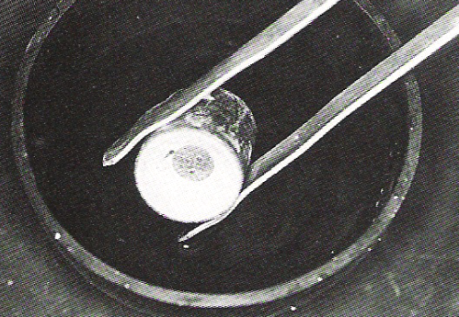
Divesting

Slide 32
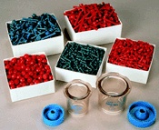
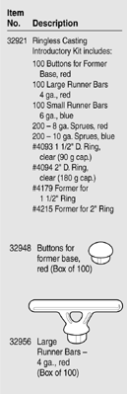

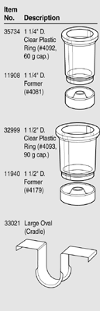
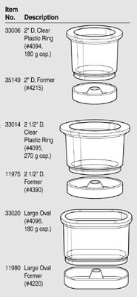
Ringless casting system
PowerCast Ringless System
Various sizes of rings and formers
Preformed wax sprues
Investment powder and liquid
Tapered plastic rings
Greater mold expansion

Slide 33
Casting defects
Casting defects can be classified as
    Distortion
    Surface roughness, irregularities and discolouration
    Porosity
    Incomplete or missing details
Casting defects can also be classified as
    Dimensionally inaccurate castings
    Having a rough surface and/or fins
    Porous, contaminated or incomplete castings

Slide 34
Distortion
Wax pattern
Investment material

Slide 35
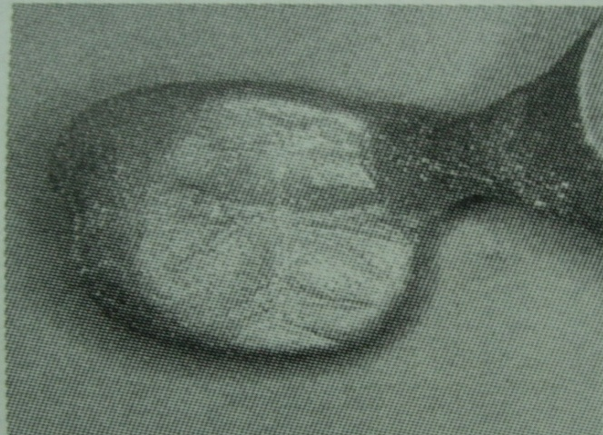
Surface roughness
Improper finishing of wax pattern
Excess surfactant
Improper w/p ratio
Too high casting pressure
Composition of the investment
Foreign bodies
Impact of molten alloy

Slide 36
Investing Procedure
IMPORTANT TIPS
  1. Investment should always be added to the water.
  2. Equipment must be kept clean and free of set investment.
  3. Close the container when not in use.
  4. Always store the investment in a dry area.
Vacuum mixer Mixing bowl

Slide 37
Burn out procedure
Heating the investment in a thermostatically controlled furnace until the wax is burned out
Creates a mold space
Provides thermal expansion of
  investment

Slide 39
Techniques
Hygroscopic low heat tech – 500° C for 60 min to 5 hours
  37° C water bath
  Warm water from top
  Thermal expansion
High heat thermal expansion tech
  Gypsum bonded - 650 – 700 ° C in 60 min & held for 15 – 30 min
  Phosphate bonded – 750 to 900 ° C , slow to 315 ° C and rapid to upper temp & held for 30 min
  Thermal expansion
  Heat of reaction expanding the wax pattern
  Setting expansion

Slide 40
Time allowable for casting
The time lapse between burn out and casting – critical
  for high heat technique
One minute can pass without a noticeable loss in dimension
Applicable for low heat technique also

Slide 41
Casting
GPT - n → something that has been cast in a mold ; an object formed by the solidification of a fluid that has been poured (or) injected into a mold
verb → The act of forming an object in a mold.
Heat source – melts the alloy
Casting force – forces molten alloy into mold
Casting force > surface tension of alloy + resistance offered by gas in the mold.

Slide 42
Heat Source
Torch melting
→ Gas air
→ Gas oxygen
→ Air acetylene
→ Oxygen acetylene
→ Hydrogen oxygen generator
Electrical melting
→ Electrical resistance melting
→ Direct current arc melting
→ Induction melting
Excess heat changes composition of alloy
Base metal alloys are made brittle

Slide 43
TAKE HOME MESSAGE
Cast restorations meet the needs of patients who require, for one or more reasons, the replacement of a rather large amount of tooth tissue. The manner of casting fabrication, by the indirect or direct methods, material selection throughout the process and their manner of use is a choice for the experienced operator. Knowledge of the advantages and disadvantages of certain techniques and materials, thoughtful exercise of the basic principles guiding their application, and critical assessment of the results of practice will help assure the highest quality of this form of restorative care.

Slide 44
QUESTIONS
Define Cast metal restorations
Classify metals used in cast metal restorations
Discuss Ideal properties of metals in cat metal restorations
List various casting defects. Methods to overcome them.
Define Porosity….types and its prevention
Types of Cast Metal Restorations.
Inlay wax

Slide 45
REFERENCES
Science Of Dental Materials -----By ANUSAVICE, Skinners.
Restorative Dentals Materials 11th Edition By Craig.
Operative Dentistry 2nd Edition By Summit, Robbins, Schwarts

Slide 46
SUGGESTED READING
Science Of Dental Materials -----By ANUSAVICE, Skinners.
Restorative Dentals Materials 11th Edition By Craig.

Slide 47
Thank You

